Slide 1
TEMPLATE

Slide 2
TEMPLATE
CELEBRATING DIFFERENCES
ANYONE WHO…

Slide 3
WHAT DO YOU THINK?
Did you have many things in common?
What were your differences?
Did you discover anything new about anybody else?
What did we learn from this game?

Slide 4
TEMPLATE
MADE BY YOUNG PEOPLE FOR YOUNG PEOPLE
FILM SCREENING

Slide 5
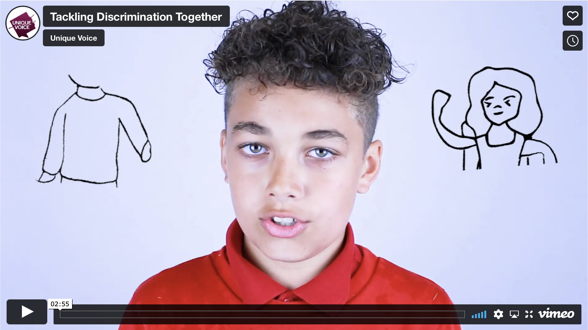
TEMPLATE
CLICK TO PLAY

Slide 6
WHAT DO YOU THINK?
How does the film relate to celebrating our differences?
Name three things mentioned in the film?
How did the film make us feel?
What could the charity Crimestoppers do to help?

Slide 7
WHAT DOES IT MEAN?
is when you are treated unfairly because of who you are, or what you believe.
DISCRIMINATION
(https://saricharity.org.uk/resources/what-is-hate-crime/)
EXAMPLE PROTECTED CHARACTERISTICS
OF DISCRIMINATION
Skin colour
Culture or
beliefs
Family
Gender
Abilities /
disabilities
What we look like
(features, hair colour,
glasses, height etc.)
Where we are from
/ where we live
Sexuality
Age

Slide 8
TYPES OF DISCRIMINATION
DIRECT
INDIRECT
Treating someone with a protected characteristic less favourably than
Putting rules or arrangements in place that apply to everyone but that puts someone with a protected characteristic at an unfair disadvantage
STEREOTYPES
ASSUMPTIONS
BULLYING
PREJUDICE
A set idea that people have about what someone or something is like, especially an idea that is wrong
Something that you accept as true without question or proof
The behaviour of a person who hurts or frightens someone less powerful, often forcing that person to do something they do not want to do
An unfavourable opinion or feeling formed beforehand or without knowledge, thought, or reason
Discrimination is when you are treated unfairly because of who you are, or what you believe.

Slide 9
TEMPLATE
EXPLORING DISCRIMINATION
INTERACTIVE DEBATE

Slide 10
TEMPLATE
EXPLORING DISCRIMINATION
INTERACTIVE DEBATE
Someone has made an insulting
remark about somebodies race

Slide 11
TEMPLATE
EXPLORING DISCRIMINATION
INTERACTIVE DEBATE
A school has asked all young people to wear a hat as part of their school uniform and as a result a child cannot wear their religious head covering

Slide 12
TEMPLATE
EXPLORING DISCRIMINATION
INTERACTIVE DEBATE
A child is being bullied because they say they have “two mums”

Slide 13
TEMPLATE
EXPLORING DISCRIMINATION
INTERACTIVE DEBATE
Everyone is invited to go to after school club but they must climb a flight of stairs to get there

Slide 14
TEMPLATE
EXPLORING DISCRIMINATION
INTERACTIVE DEBATE
Answers revealed
Someone has made an insulting remark about somebodies race (Direct)
A school has asked all young people to wear a hat as part of their school uniform and as a result a child cannot wear their religious head covering (Indirect)
A child is being bullied because they say they have “two mums” (Direct)
Everyone is invited to go to after school club but they must climb a flight of stairs to get there (Indirect)

Slide 15
WHAT DO YOU THINK?
Who in our lives influence our opinions?
How do we make informed choices and opinions?
What do we do if the people in our lives have a different opinion to ours, that we know to be wrong?
Why is important to debate about our opinions?

Slide 16
WHAT DOES IT MEAN?
is when someone commits a crime and shows hostility towards someone because of their race, disability, religion, sexual orientation, gender identity or any other protected characteristic.
HATE CRIME
A HATE CRIME COULD INCLUDE:
THREATS
HARASSMENT
VIOLENCE
DAMAGING
PROPERTY
A statement of an intention to inflict pain, injury, damage, or other hostile action on someone
Behaviour which frightens you and causes you distress or alarm
Behaviour involving physical force intended to hurt, damage someone or something
Inflicted damage to something the person owns (house, car, phone etc)

Slide 17
TEMPLATE
THE FEELINGS AND EMOTIONS SURROUNDING HATE CRIME
EMOTIONS FISH TANK

Slide 18
HATE CRIME IS A CRIMINAL OFFENCE AND NEEDS TO BE REPORTED TO THE POLICE OR CRIMESTOPPERS
Key Facts about Crimestoppers
Crimestoppers is a charity and NOT a part of the police
Crimestoppers will pass on your information to the police for you
The number to call Crimestoppers is 0800 555 111
Website is www.crimestoppers-uk.org
When you call Crimestoppers you are completely anonymous
Crimestoppers can be used to report any crime or suspicious activity.
Note that children cannot call Crimestoppers alone - it is important to gain the help of a trusted adult
Hate crime can happen online, in the street, at school, college, work or at home.
Remember, if you are in immediate danger or it is an emergency you should call the police on 999.

Slide 19
TEMPLATE
II
WHAT HATE CRIME LOOKS LIKE
HATE CRIME
FREEZE FRAMES

Slide 20
TEMPLATE
II
WHAT HATE CRIME LOOKS LIKE
HATE CRIME FREEZE FRAME
THREATS
VIOLENCE
DAMAGING
PROPERTY
HARASSMENT

Slide 21
WHAT HAVE WE EXPLORED SO FAR?
We have:
Celebrated what makes us different
Identified what discrimination is
Explored example types of discrimination and how this might feel
Identified what hate crime looks like
WHO CAN WE TALK TO?
Who are the key trusted adults?
Who else can we report to?

Slide 22
TEMPLATE
BEAT POEM CREATION
OUR VOICE

Slide 23
BEAT POEM CREATION
OUR VOICE
POEM STARTER VERSE
With our voices, we can make a change.
We can bring an end to the fear and pain.
We have the power to speak out, stand tall,
Our community belongs to us all.

Slide 24
TEMPLATE
CLOSING DISCUSSION

