Slide 1





TEMPLATE

Slide 2
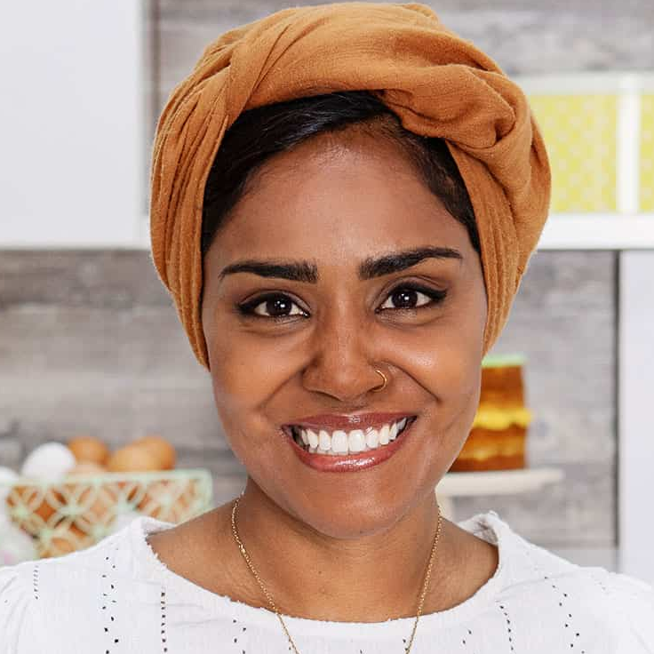
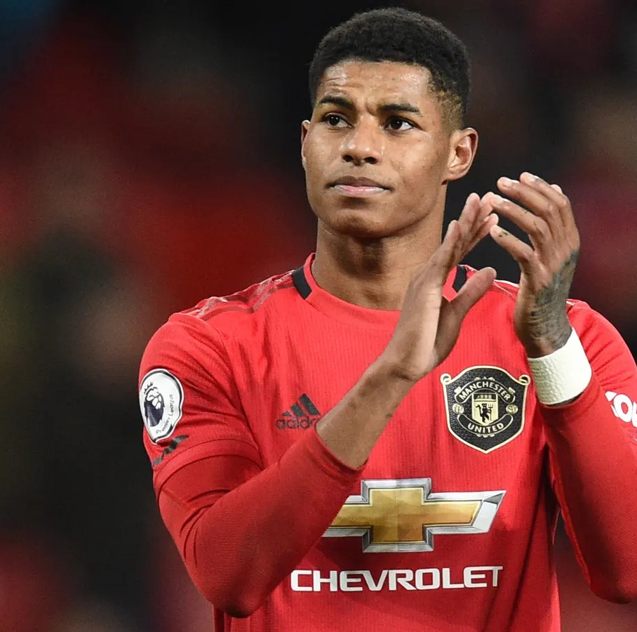
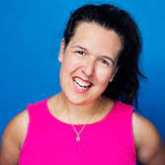
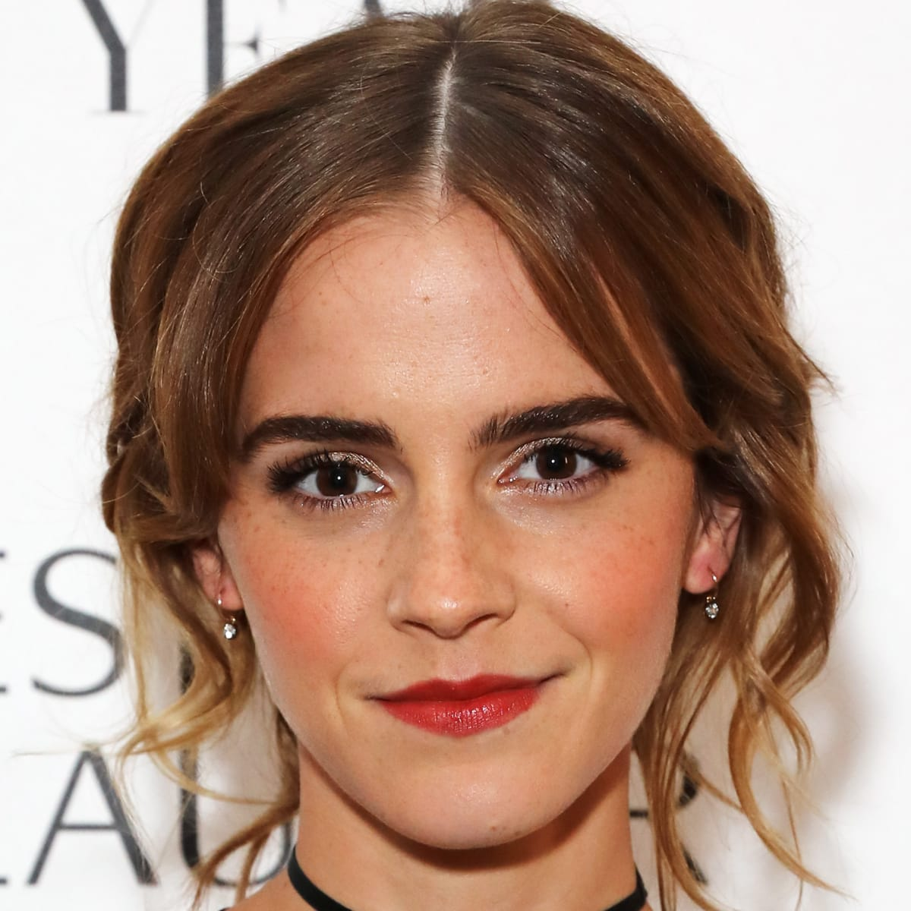
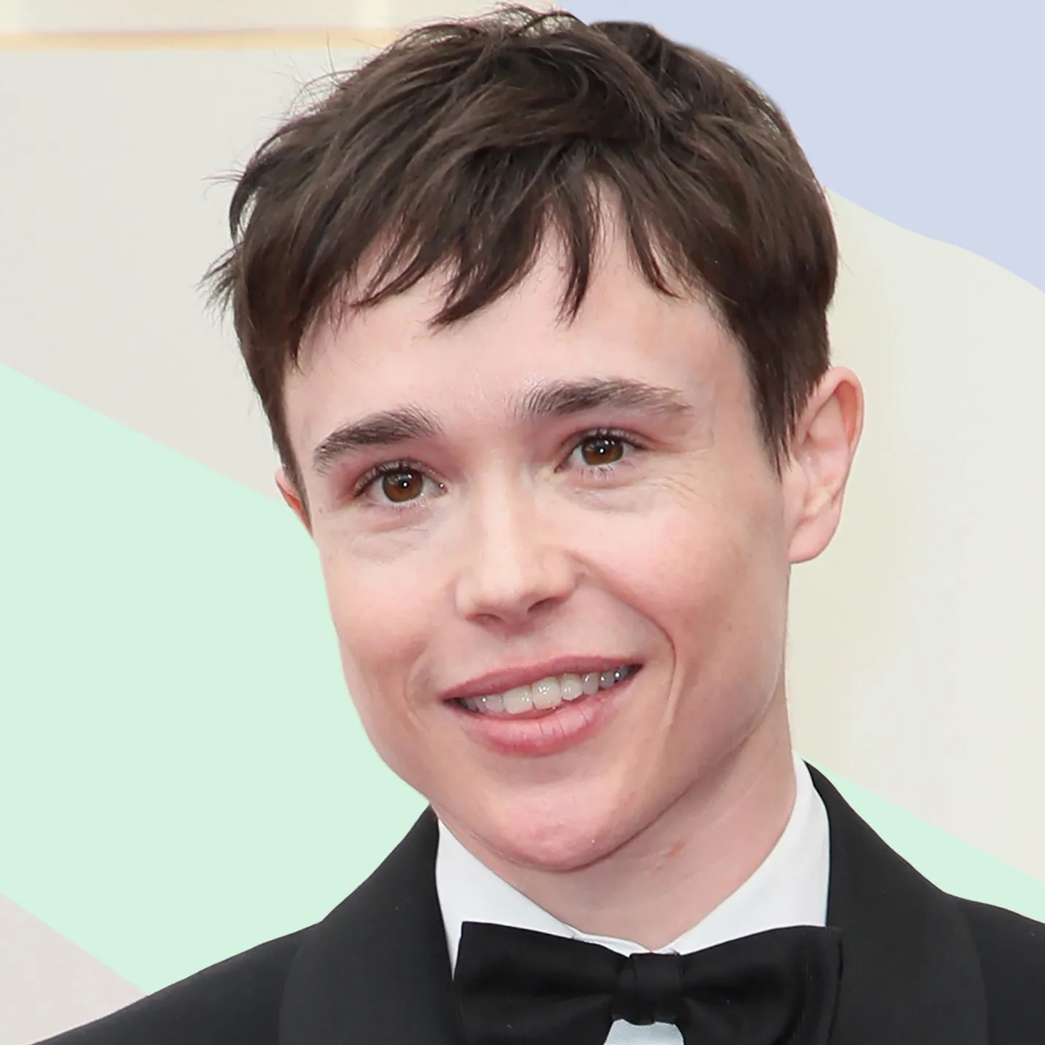
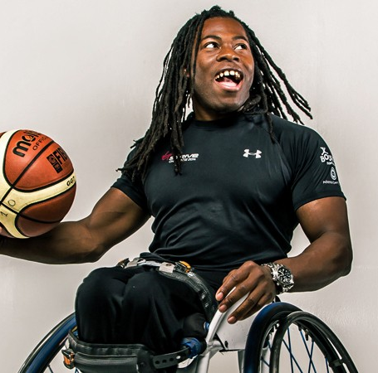
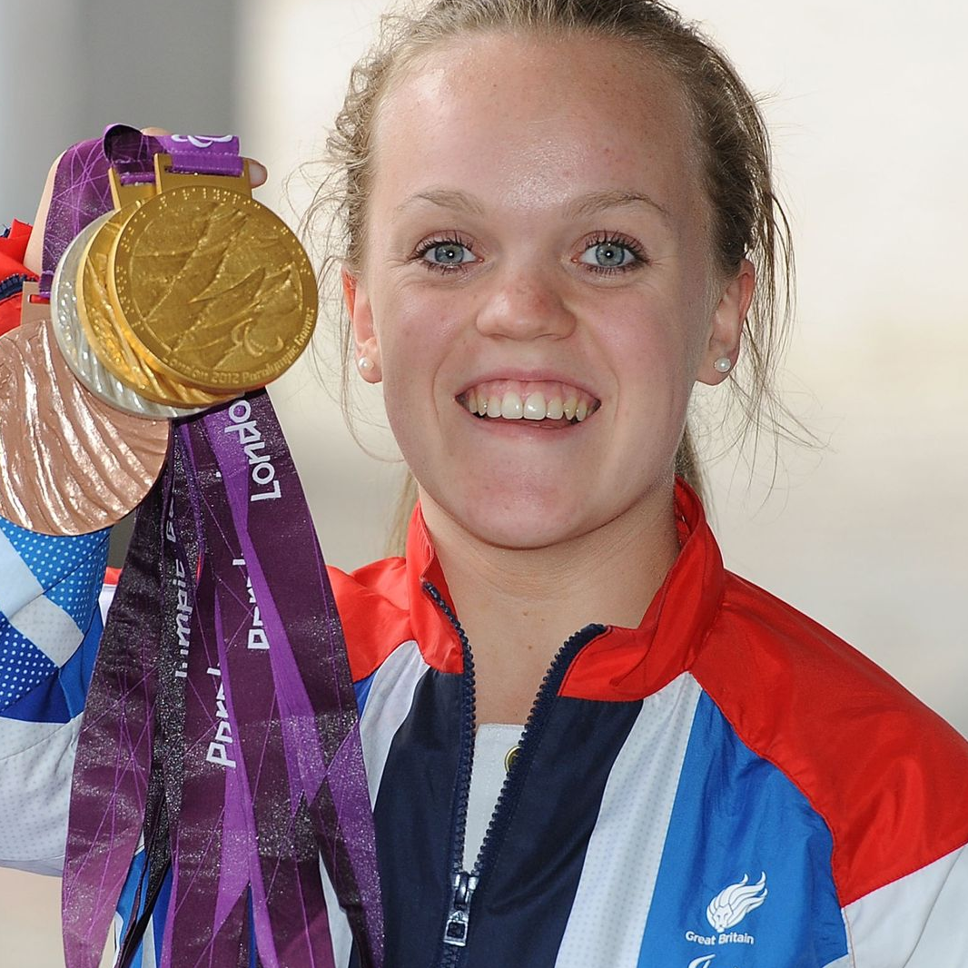
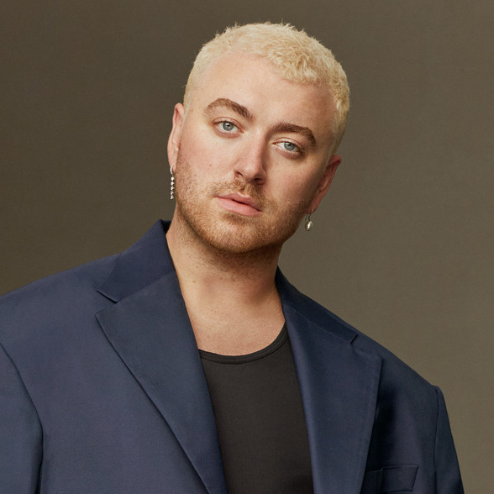
TEMPLATE
What do you think all of these people have in common?
- Nadiya Hussain -
Wasn’t able to audition for a modelling job because of her skin colour
- Marcus Rashford -
Encountered racial abuse for missing a penalty in the Euros 2020
- Rosie Jones -
Encountered online threats and abuse against her disability
- Emma Watson -
After experiencing gender discrimination, Emma sought to promote women’s rights and women’s political participation
- Elliot Page -
Received LGBT harassment and slurs on social media after coming out as transgender.
- Ade Adepitan -
Experienced disability discrimination during his sporting career
- Ellie Simmonds -
Experienced harassment and bullying when she appeared on Strictly Come Dancing
- Sam Smith -
Experienced discrimination against his gender identity and sexual orientation

Slide 3
TEMPLATE
DEFINITION:
Discrimination is when you are
treated unfairly because of who you
are, or what you believe.
(saricharity.org.uk)

Slide 4
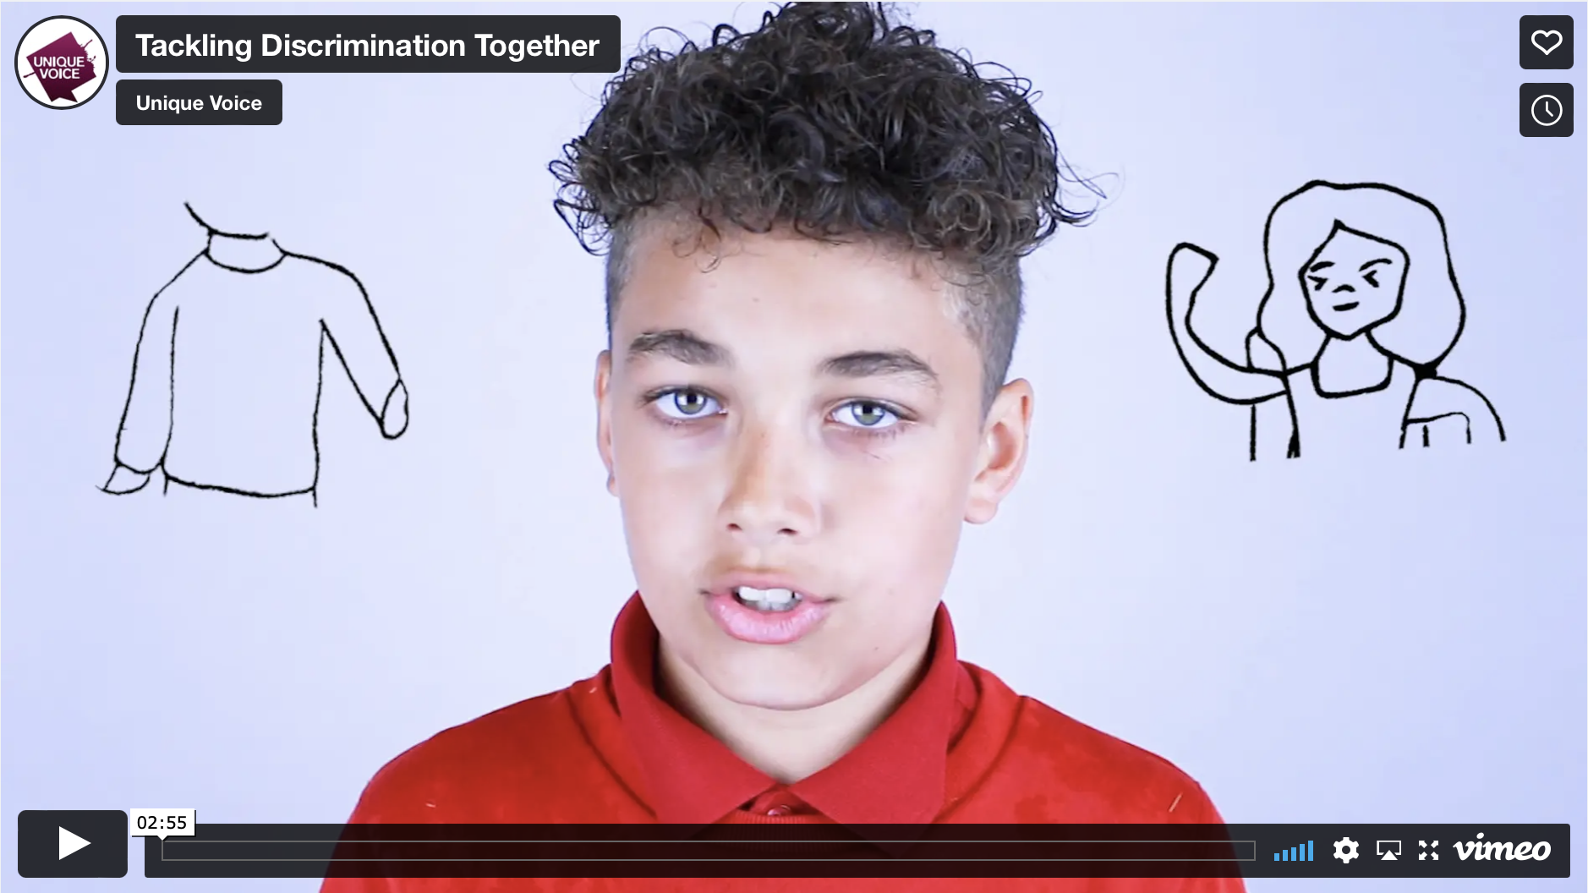
TEMPLATE
CLICK TO PLAY

Slide 5

WHAT DO YOU THINK?
What happened in the film?
Name three types of discrimination that were mentioned in the film
How did the film make us feel?
What could the charity Crimestoppers to to help?
do to help?

Slide 6

EXAMPLE PROTECTED CHARACTERISTICS
OF DISCRIMINATION
Skin colour
Culture or
beliefs
Family
Gender
Abilities /
disabilities
What we look like
(features, hair colour, glasses, height etc.)
Where we are from
/ where we live
Sexuality
Age
We all have a right not to be treated less favourably, or subjected to an unfair disadvantage, by reason of our given characteristic. These characteristics are known as protected characteristics.

Slide 7
TEMPLATE
HOW WOULD YOU FEEL ?
Name some key words associated with how discrimination may make us feel

Slide 8
TEMPLATE
THE WEIGHT OF
DISCRIMINATION

Slide 9
TEMPLATE
?
WHAT CAN WE DO?

Slide 10
TEMPLATE
?
WHAT CAN WE DO?
SCENARIOS
A building you are going into on a school trip doesn’t allow you access because of a disability
You are being excluded from a sports team because of your skin colour
You are being bullied because you didn’t grow up in the same place as your peers
You get a job in the future but you are paid less than your co-worker because of your sex

Slide 11
TEMPLATE
Our backpacks are always there and can be re-filled based on the actions, thoughts and opinions of others.
How we can stop the backpack filling up again in our society?

Slide 12
TEMPLATE
SIT UP
acknowledge that discrimination exists
STAND UP
noticing when it happens and be committed to making it stop
SPEAK UP
about the negative behaviour by reporting to someone

Slide 13
TOP TIPS
Know who could help in your school/setting or home - who is a trusted adult in your life?
Report if you see something that you think is wrong, tell someone who you trust; the police, teacher, Crimestoppers, family, club leader.
Keep a record. If you think you or someone around you is experiencing discrimination, record or write it down so you can show your trusted adult about the times it’s happening.
Think about your actions and words! How does the way you speak and act affect others around you? How would you feel if you were discriminated against?

